Slide 1
Optional Schools Open House 2024-25

Slide 4
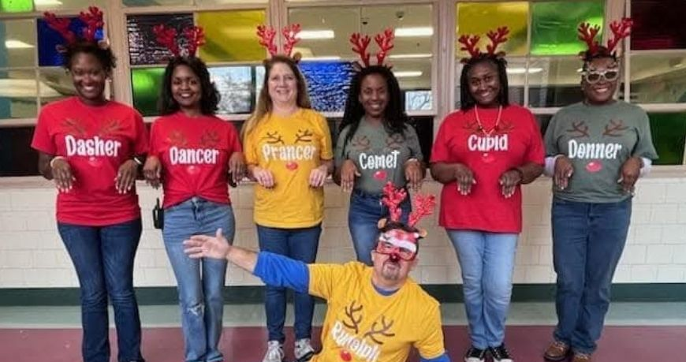

Slide 5
Administration
Principal
Mr. Pete Johnson
Assistant Principal
Ms. Mattie Smith
PLC Coach
Mrs. Rica Davis
Optional Schools Coordinator
Mrs. Rachel Helton Johnson
Instructional Facilitator
Mrs. Carin Fuller
Guidance Counselors
Ms. Devonne George & Ms. Rekeshia Hudson

Slide 6
Grahamwood Elementary School has been a beacon in the community for the past 75 years. In 1949, its doors opened to students ready to learn something new. That tradition of excellence hasn’t stopped yet. Grahamwood is considered a school within a school. We served our neighborhood and students who qualify for the Optional program. Enriched Academics is the focus of our Optional Program. There are 874 students this school year. 69% are in-district students and 31% are Optional students. 22% of our students qualify for the gifted CLUE program.

Slide 7
Over 1,049 years of combined educational experience
Faculty Qualifications 100% hold a Bachelor’s degree 73% hold Master’s degree or higher 7% hold Ed.S or Doctorate degrees 4 National Board Certified Teachers 18.4 years average teaching experience

Slide 8
Traditionally, one of the most requested and sought-after schools, Grahamwood is most known for its exceptional teaching staff, strong community support, and unparalleled parent involvement. One of the things that makes Grahamwood unique is our dual program model.

Slide 9
Serving a remarkably diverse population, Grahamwood meets each child’s unique educational needs by utilizing a hands-on approach where the entire community serves as a learning laboratory for the students to explore.
Points of Pride | Academics | Activities
School Seed Grant recipient for Lowe’s Governed Teacher Grant recipient MSCS first ever District-wide Spelling Bee Champion Culturally diverse programs throughout the school year Participants in the West TN Naturalization Ceremony 5th grade choir performs yearly for the Memphis Grizzlies Upgrade to Tennessee Wildlife Certified Outdoor Classroom Extremely diverse student population 5% Asian 31% African American 23% White 34% Hispanic 8% Other Strong and visible parent organization | 73% of staff has advanced degrees Four National Board-Certified Teachers Rigorous academics using hands-on exploration and discovery learning methods. Project-based instruction National Junior Beta Club School Distinction from 2013 to present. CLUE classes for eligible students in KK through 5th grades (largest CLUE population in MSCS) Science and STEM labs | Music Clubs: Guitar, Orff, Advanced Recorder, Class Piano, Orchestra, and Choir Afterschool Clubs: Art Club, St. Jude STEM Club, Perfect Pearls Etiquette & Mentoring Club, The Way Bible Club, Girl Scouts, Cub Scouts, Lego League, and Club Invention Sport Clubs: Soccer Shots, Cheerleading, Yoga, and Basketball Other: Vocabulary Parade, ESL Night, Celebration of Cultures, Jump Rope for Heart, Boosterthon, Raised Garden Beds, Academic Tutoring Camp Invention Summer program

Slide 10
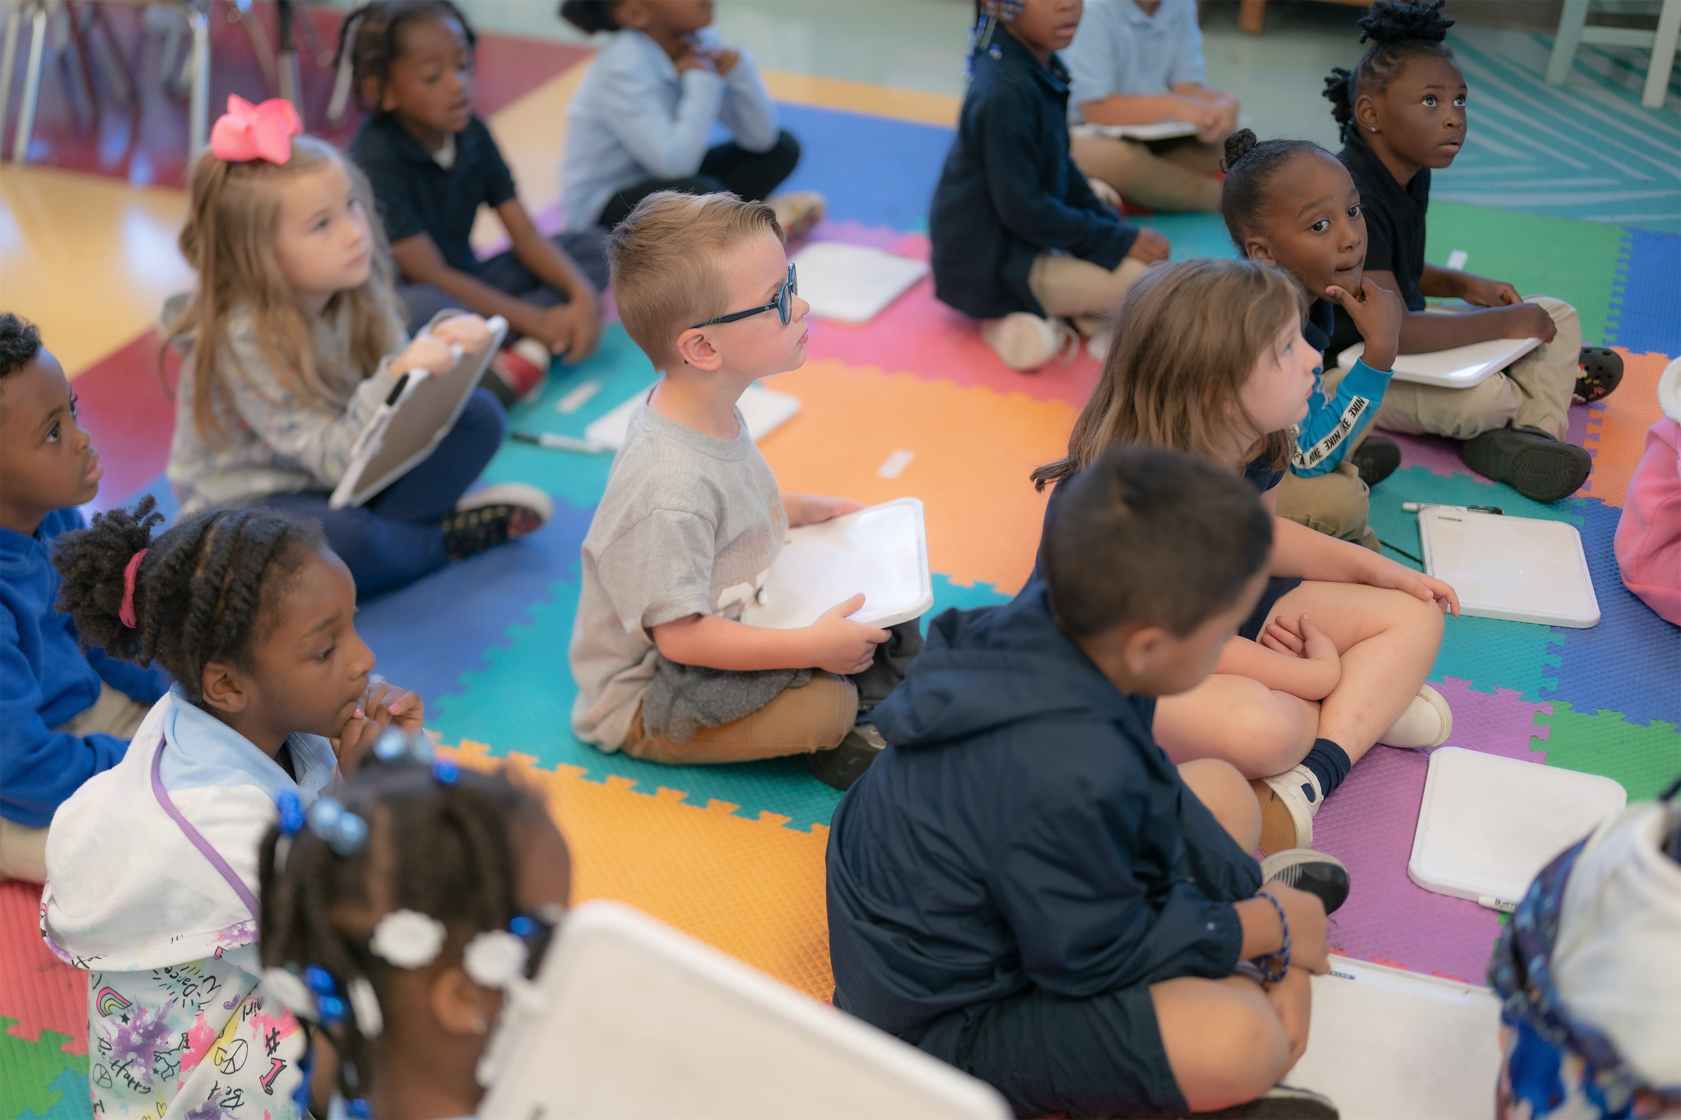
Why choose Grahamwood?

Slide 12
Why choose Grahamwood?
As a current GES student parent:
Teachers/staff treat my child as their own and always provide her with positive assertiveness that she loves. We trust the GES staff supporting child socially and academically. She’s challenged and offered with various in-school and after-school programs. She has been exploring and participating with many exciting opportunities at school. We are so thankful to find and belong to this special school.
The level of care that staff members put into not only educating the children but the level of love as well. The creative way the lessons are delivered. The exposure the kids get from fieldtrips and the diversity of the classrooms. Grahamwood is an amazing school.
I've been a teacher at Grahamwood for the last ten years and it has always felt like home. The reason I chose Grahamwood is because of the diversity, academics and leadership that our school provides. Being immersed every day in a school environment with students that speak multiple languages and teachers that have high expectations is a dream come true. I hope to continue being a great teacher here at Grahamwood and hopefully I'll be able to send my own child to Grhamwood in the future.

Slide 13
Why choose Grahamwood?
As a former GES student parent:
Grahamwood was the place where my child felt welcomed and found comfort for years; since we walked in for the first time and didn’t know a single soul. The guidance and instruction could be challenging at times, but it all trained my now-high schooler to be a successful and thriving student; physically and mentally. Thanks to Grahamwood’s family. She wishes she could have gone from KK-12th, if those were available at Grahamwood.
Culture. Care. Trust. These qualities make up the community that I’ve been blessed to serve. It is one of a kind, absolutely. I am privileged to be a part of such an advancing part of education. Grahamwood is a phenomenal place to work.
I chose Grahamwood because I wanted my daughter to have enrichment. She was not being challenged at her former school. I also wanted her to be around a diverse community just like our city. I wanted her to learn about various cultures and what better way to learn than hands on experience everyday. My daughter is now a senior in college and applying to medical school. I firmly believe Grahamwood gave her the foundation she needed to be a successful adult both academically and personally.

Slide 14
Why choose Grahamwood?
There are 12 members of our staff that have educated children over 30 years.
There are 10 staff members that have been at Grahamwood over 25 years.
There are 3 staff members that have educated children over 40 years.
There are 30 staff members that family are attending Grahamwood currently or have attended in the past.

Slide 15
How can my child become a student at Grahamwood?

Slide 16
First and Second Grade Applicants
MSCS: First and second grade applicants must score at or above the 80th percentile in reading and mathematics on iReady Diagnostic test.
NON-MSCS: First and second grade applicants must take the Optional Schools admittance tests, scoring at or above the 80th percentile in reading and mathematics.
First grade applicants must have satisfactory skills, behaviors and achieve mastery in all academic and support subjects on the most recent kindergarten report card.

Slide 17
Third – Fifth Grade Applicants
Third – fifth grade applicants must score at or above the 80th percentile on school-based administration of the iReady Diagnostic Reading and Math assessments (2024-25); or score at or above the 80th percentile on the TCAP Achievement English Language Arts and TCAP Achievement Mathematics assessments; or score at or above the 80th percentile on the Total Reading/Reading Composite and Total Mathematics/Mathematics Composite of an acceptable nationally normed achievement test. Acceptable tests in person must be dated Spring 2024 or later.

Slide 18
Optional Applicants
Second - fifth grade applicants must have A’s, B’s, E’s, G’s, and S’s in all subject areas and satisfactory conduct on most recent comprehensive report card.
All applicants must have satisfactory attendance, including promptness to school, with no more than 10 absences, and 10 tardies/early dismissals for the year.
To remain in the Optional Program, students must maintain the listed requirements for grades, conduct, skills and behaviors, academic and support subjects, attendance and parent support.
Application for admission must be renewed yearly.

Slide 19
Optional Applicants
The online application portal will be accessible on the MSCS website, www.scsk12.org, beginning at 10 a.m. on Tuesday, January 28, 2025. A valid email address is required in order to submit the application online. Current MSCS students are encouraged to use their PowerSchool student number. For non-MSCS students, a social security number is requested. You will receive an email confirmation with the date and time of your application submission.

Slide 20
General Choice Transfer
The General Choice Transfer process allows parents to choose a different school that best fits their child’s educational needs if space is available in the chosen school and the school does not have admission criteria.
The General Choice transfer process is completely online to afford the most opportunities for students and families in Memphis Shelby County. No paper applications are printed or accepted. Parents can easily apply and submit an application from any personal computer with internet access or smartphone/tablet that supports online forms. The online application portal will be accessible from the Memphis-Shelby County Schools website, www.scsk12.org, beginning at 10 a.m. on Tuesday, January 28, 2025.
Parents who complete ALL registration and enrollment requirements for the upcoming school year (2025-26) and apply during the priority application period will be notified of their child’s status prior to the end of the 2025-26 school year.

Slide 21
Meet our Optional School Teachers

Slide 22
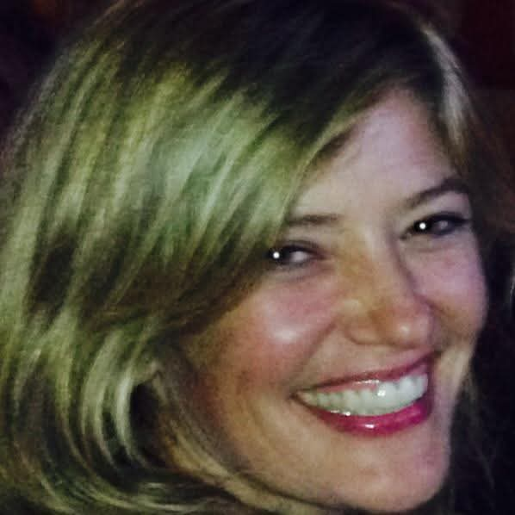
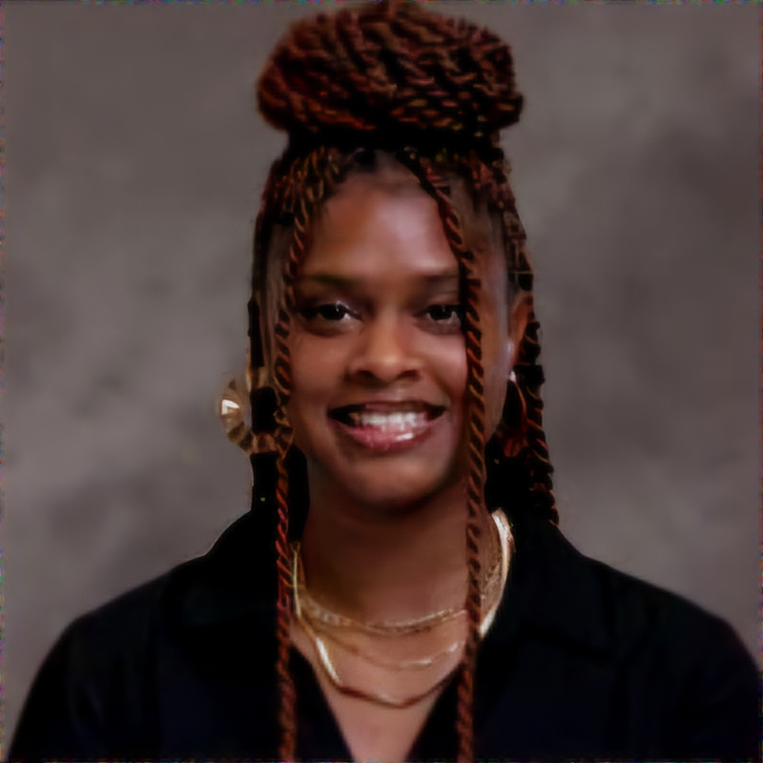
1st grade
Mrs. Bayne Ms. Brooks Ms. Paris

Slide 23
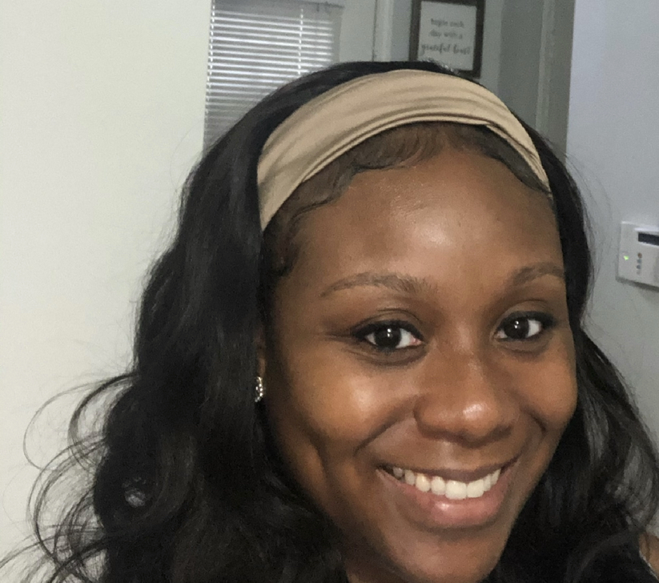
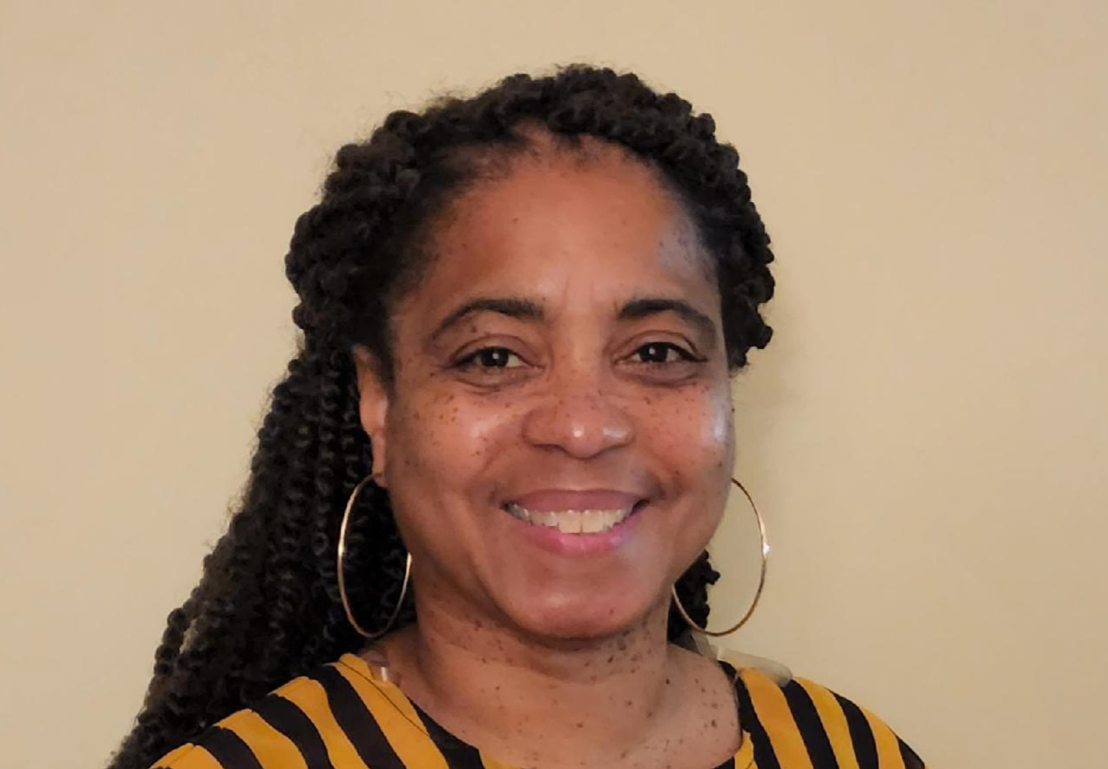
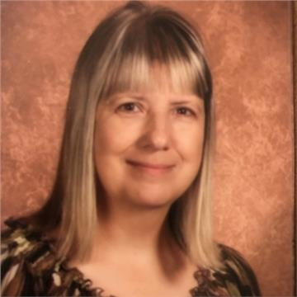
2nd grade
Mrs. Chambers Mrs. Davis Mrs. Mendillo

Slide 24
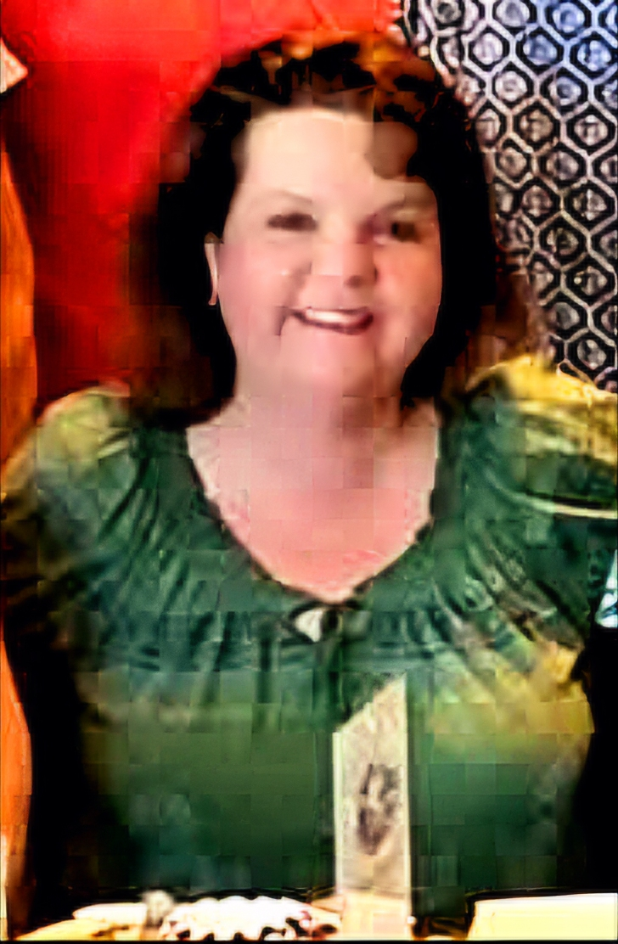
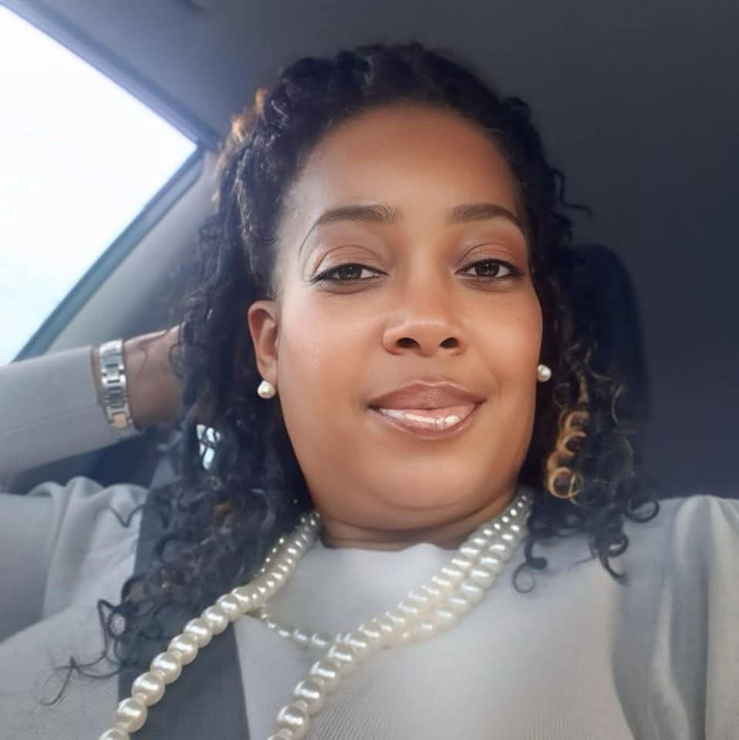
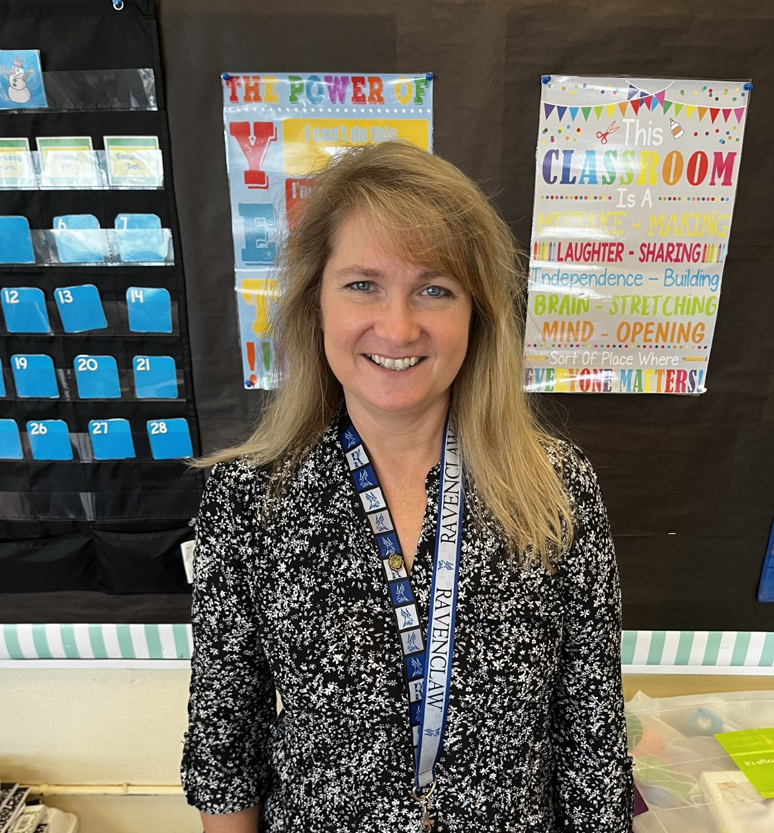
3rd grade
Ms. Ferreira Ms. Morris Ms. Young

Slide 25
4th grade
Mr. Diaz Ms. Kendrick Mrs. Davis

Slide 26
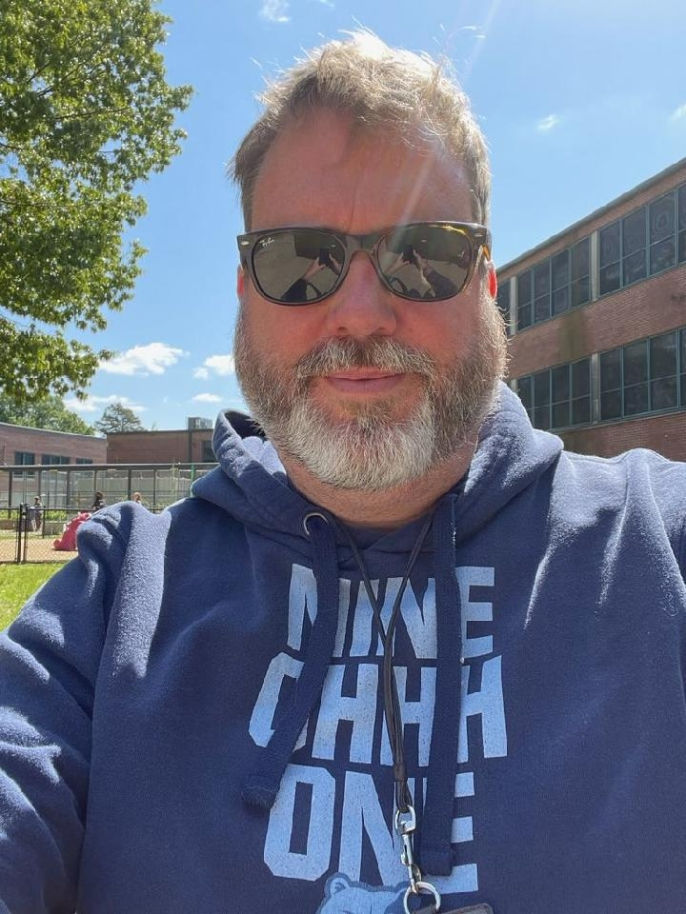
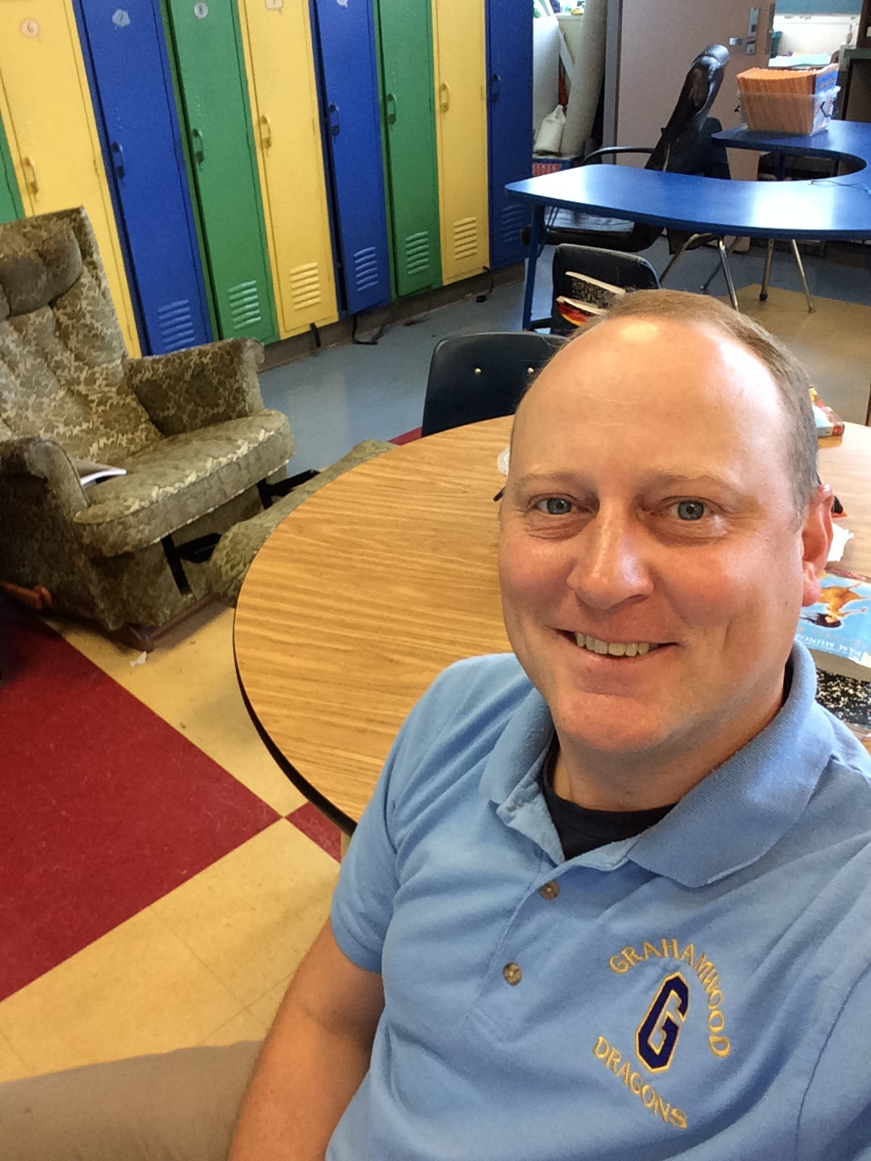
5th grade
Mr. Emerson Mr. Coleman

Slide 27
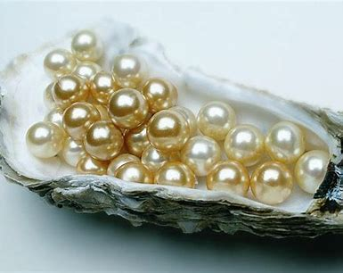
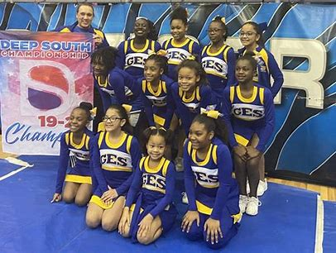
Grahamwood has so much to offer your child!

Slide 29
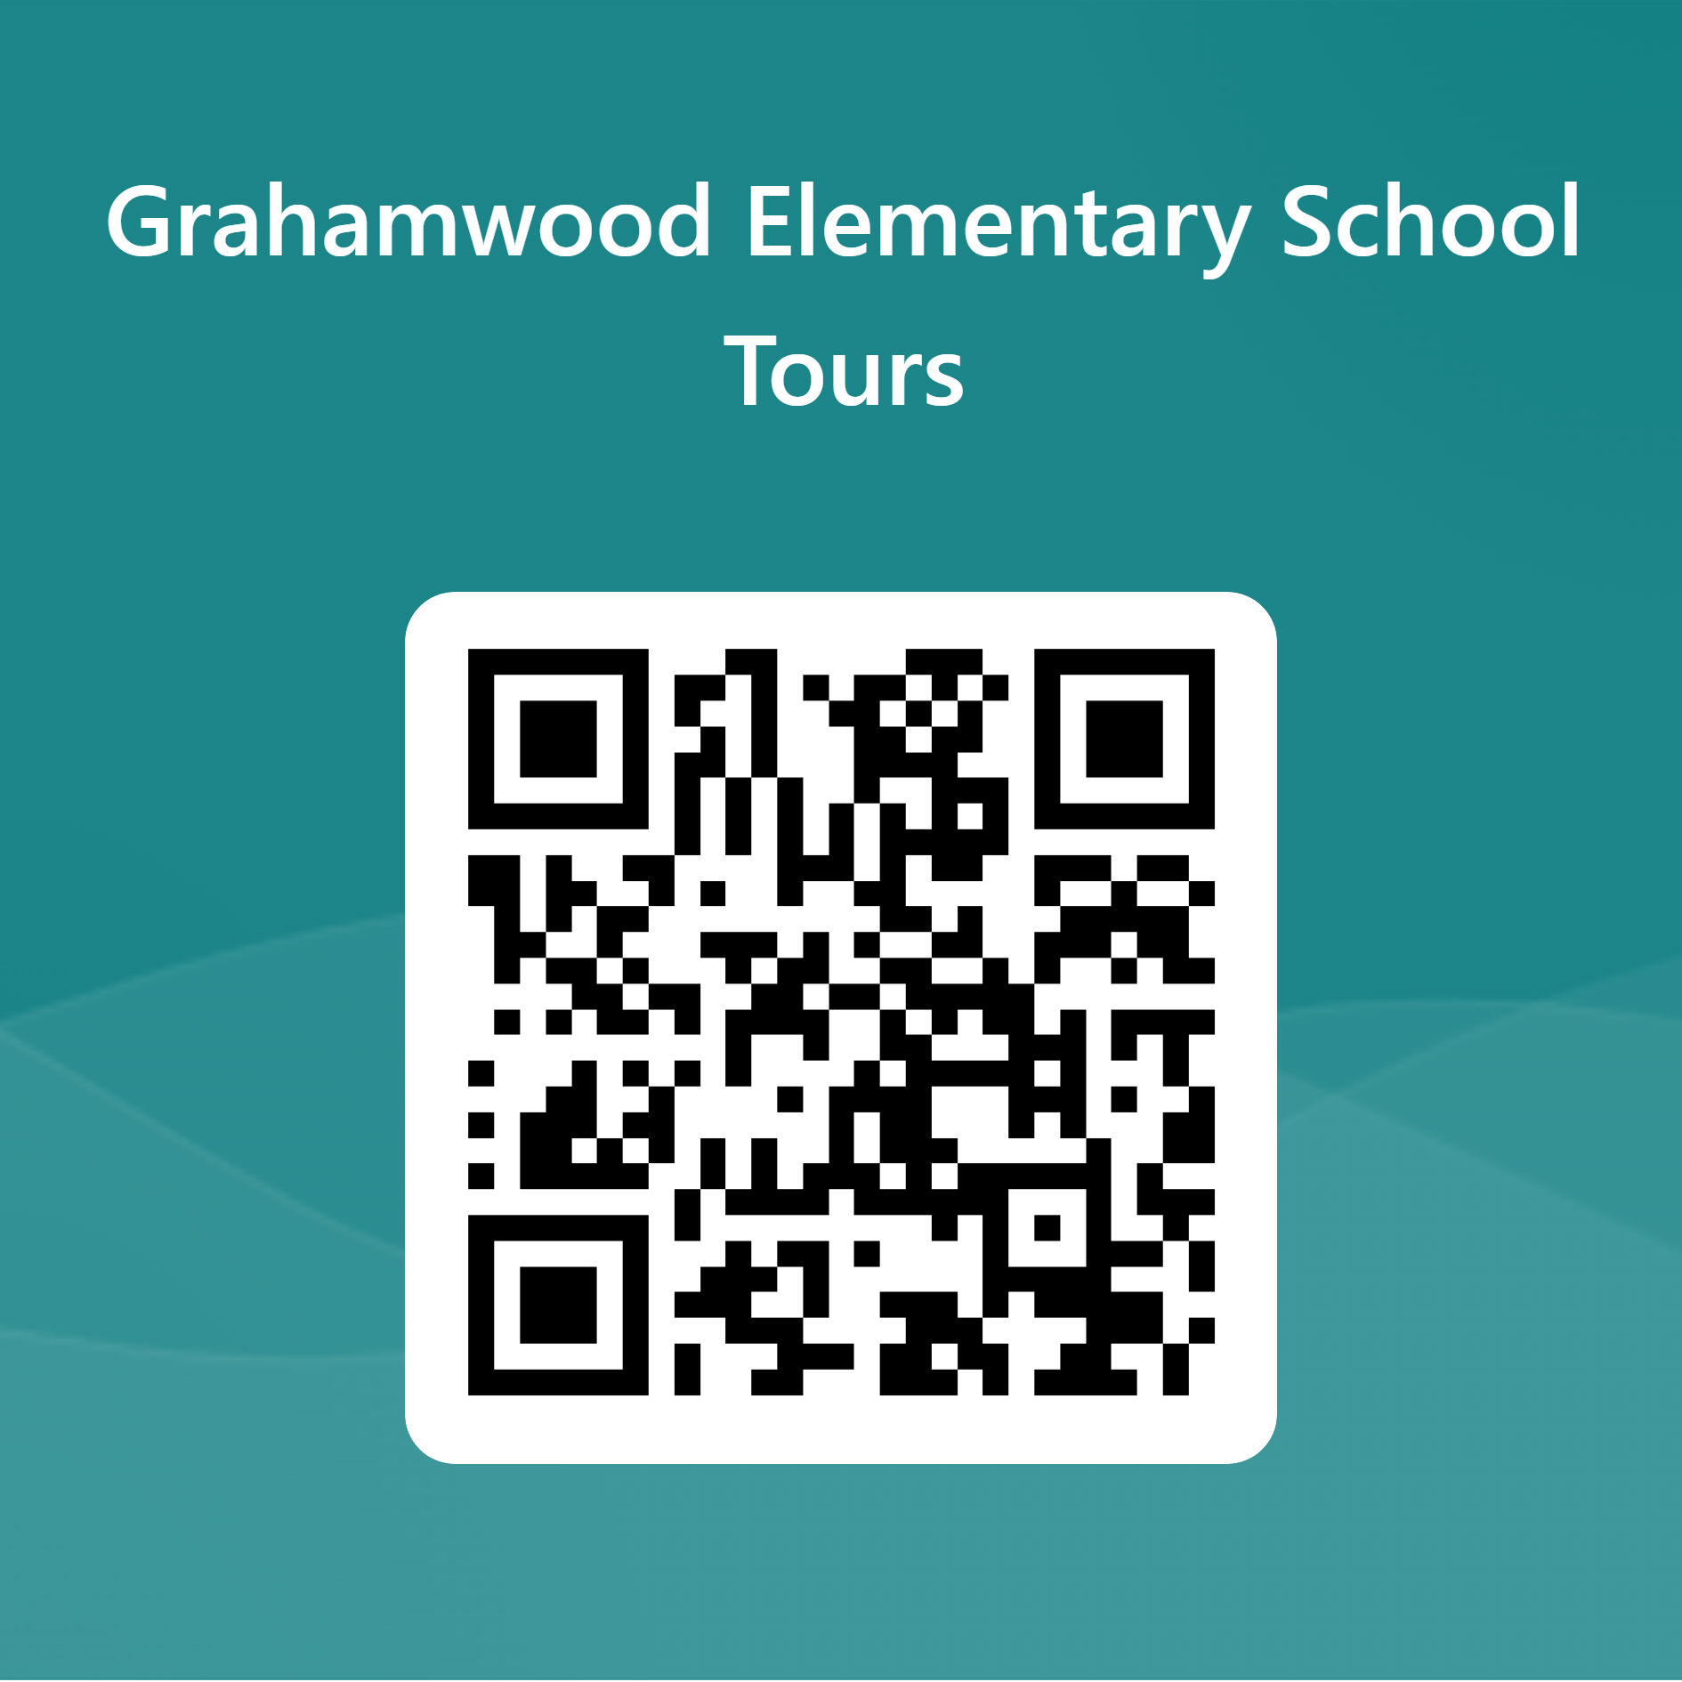
Are you interested in a school tour?

Slide 30
Make sure you follow us on Facebook. You can also visit our website for more information.
Grahamwood Elementary / Homepage (scsk12.org)

Slide 31
Rachel Helton Johnson
heltonrd@scsk12.org
901.416.5993

